Slide 1
For Live Session
Unit 4
Carlos estevez

Slide 2
For Live Session:
Run the example code in the file Unit 4 Web Scraping.R This will help tremendously with the web scraping in Part 1. You will have to learn the grep and grepl functions which I think you will find very useful and we will extend on in the future. (1 hour)
We did and we learned about different concepts in the lesson including web scrapping and tidy data

Slide 3
Part 1: Restaurant Data from Baltimore!
Note: one of the methods learned in the last unit will work with the the improper XML code that the URL below yields and the other will create an error. Use one to get the job done.
(2- 4 hours)
You have been hired by a restaurateur to some research on Sushi restaurants in Baltimore.
You have come across data on the web contained in the following XML file.
Data: https://d396qusza40orc.cloudfront.net/getdata%2Fdata%2Frestaurants.xml
1-Scrape the XML page for name, zipcode and city council district. (Use either the XML or rvest package.)
2-Make a dataframe with just those columns.
3-Are there any Sushi restaurants in Baltimore? (Where the dataset is from.)
If so, can you estimate how many?
4-Filter the dataframe for just downtown restaurants (Council District 11).
5-Are there any Sushi restaurants downtown? # research the “grep” function
If so, estimate how many “Sushi” restaurants are in Downtown
6-Make a barplot of the estimated number of restaurants (Sushi or otherwise) in each council.

Slide 4
For Live Session Part 2: Freestyle! f
Install and load one of the packages given in the list for downloading APIs (or another API you have found and are interested in).
Download data from that API and create a slide that clearly describes the package and how (the code) to download data from that API.
Clearly describe the data and the columns / variables that are of interest to your presentation.
Perform a small EDA with your data. Use plots and possibly tests, to find 2 interesting characteristics of the data that you accessed through the API.
Create a PPT presentation to show in the live session.
Show part or all of the data and make sure to show the data are tidy.
Include at least 1 plot or chart from ggplot.
You should have no more than five slides (including the title slide).
Include your code.
Also include a discussion of any obstacles you ran into and went around or over in the process… there will inevitably be one and likely more. ☺

Slide 5
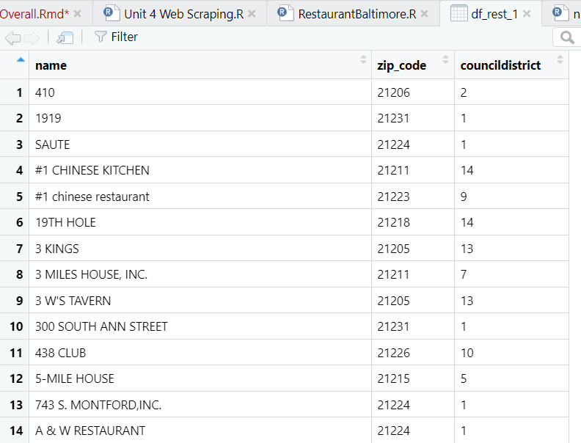
Part 1: Activity 1 and 2
1-Scrape the XML page for name, zipcode and city council district. (Use either the XML or rvest package.)
2-Make a dataframe with just those columns.

Slide 6
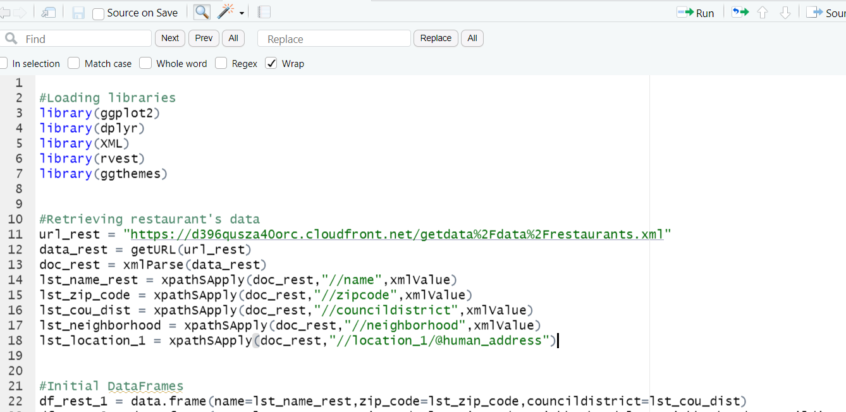
Part 1: Activity 1 and 2
1-Scrape the XML page for name, zipcode and city council district. (Use either the XML or rvest package.)
2-Make a dataframe with just those columns.
>Scrapping and Using XML
>DataFrame with the columns indicated

Slide 7
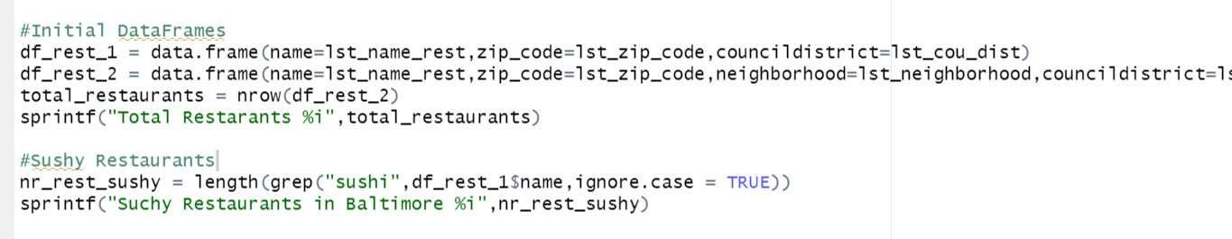
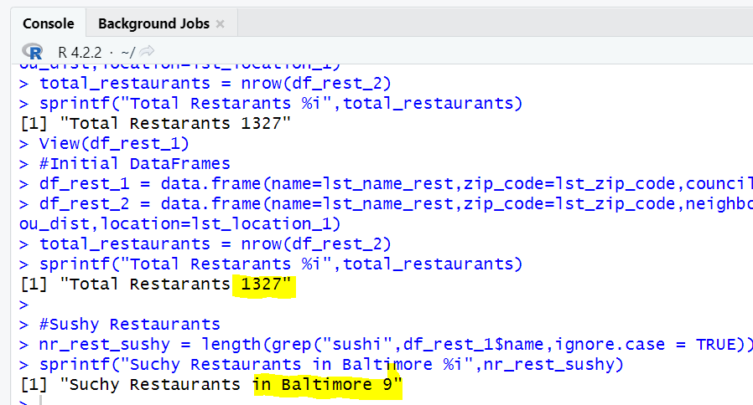
Part 1: Activity 2
3-Are there any Sushi restaurants in Baltimore? (Where the dataset is from.)
If so, can you estimate how many? Yes, there are 9 sushi restaurants in Baltimore
>As you can see in the image, we use GREP to find the possible sushi restaurants in Baltimore
>We made sure that cases are ignore so our calculation will be more accurate

Slide 8
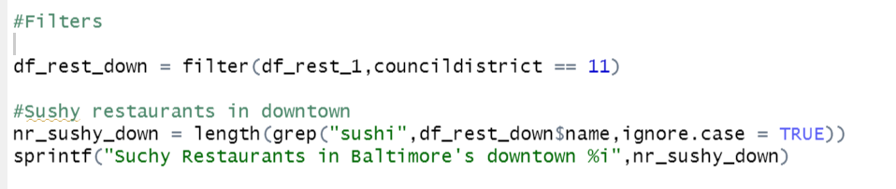
Part 1: Activity 4 and 5
4-Filter the dataframe for just downtown restaurants (Council District 11).
5-Are there any Sushi restaurants downtown? # research the “grep” function
Yes, there’s one sushi restaurant in Downtown
>We use the filters to select the downtown areas
>We use grep to determine the number of sushi restaurants using the filtered dataframe of the last statement

Slide 9
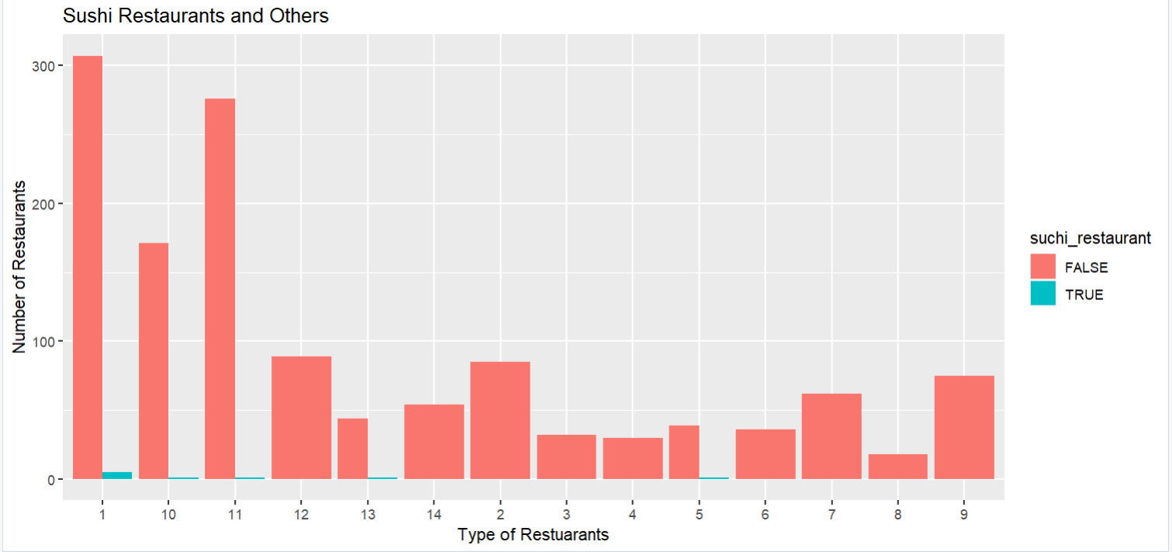
Part 1: Activity 6
6-Make a barplot of the estimated number of restaurants (Sushi or otherwise) in each council.

Slide 10
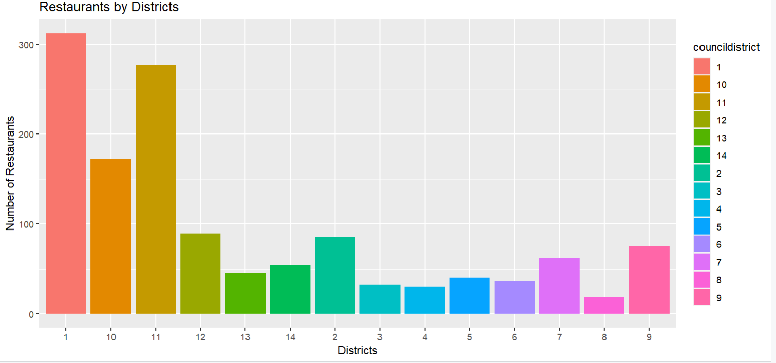
Part 1: Activity 6
6-Make a barplot of the estimated number of restaurants (Sushi or otherwise) in each council.

Slide 11
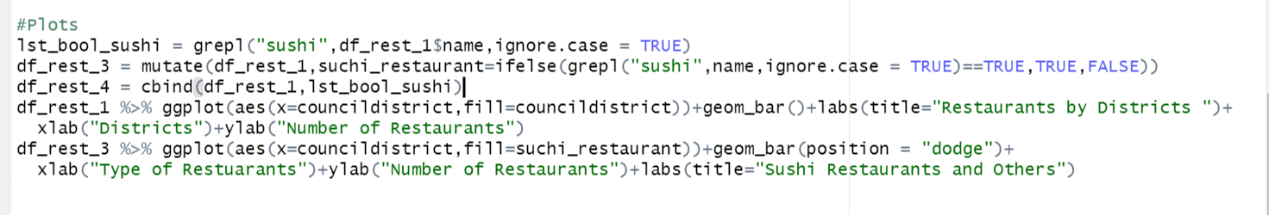
Part 1: Activity 6
6-Make a barplot of the estimated number of restaurants (Sushi or otherwise) in each council.
>Here we plotted the number of sushi restaurants in Baltimore
>We had to use grepl in order to add a new column with the restaurant type and classification

Slide 12
Part 1: Activity 4 and 5
4-Filter the dataframe for just downtown restaurants (Council District 11).
5-Are there any Sushi restaurants downtown? # research the “grep” function
Yes, there’s one sushi restaurant in Downtown
>We used the filters to select the downtown areas
>We used grep to determine the number of sushi restaurants using the filtered dataframe of the last statement

Slide 13
For Live Session Part 2: Freestyle! f
Install and load one of the packages given in the list for downloading APIs (or another API you have found and are interested in).
Download data from that API and create a slide that clearly describes the package and how (the code) to download data from that API.
Clearly describe the data and the columns / variables that are of interest to your presentation.

Slide 14
For Live Session Part 2: Freestyle! f
Install and load one of the packages given in the list for downloading APIs (or another API you have found and are interested in).
We will use the API: nbastatR
A package to help us to master the NBA data universe in R
We need to install the following packages:
Install githubinstall → install.packages("githubinstall")
Install devtools→install.packages("devtools")
devtools::install_github("abresler/nbastatR")
Load the library
library(nbastatR)
Official Documentation:
https://www.rdocumentation.org/packages/nbastatR/versions/0.1.12020301
Additional Documentation
https://towardsdatascience.com/how-to-get-data-on-every-nba-player-using-r-62abcacd65e1
Repository
https://github.com/carlosAtestevez/SMU_MSDS_6306.git

Slide 15
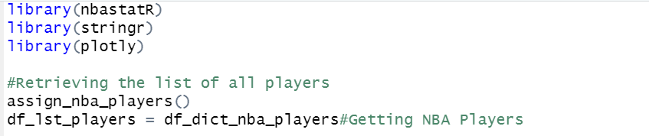
For Live Session Part 2: Freestyle! f
Function we will use:
assign_nba_players() →It will retrieve all NBA players. The data will be stored in the variable: df_dict_nba_players
players_awards()→It will retrieve the awards of a player, we need to provide the player id
players_careers()→It will retrieve the career stat data for every player
Image1: Example loading the library and getting the NBA players

Slide 16
For Live Session Part 2: Freestyle! f
Image 2: Getting the player ID using GREP to retrieve data by Name
Image 3: Getting the player Awards by Player ID
Image 4: Getting the player career Stats by Player ID

Slide 17


Exploratory data analysis(EDA)
LBJ vs MJ(Using nbastatR) f
For a long time we have considered Michael Jordan as the best NBA player of all time, nevertheless a current star has complicated that GOAT (greatest of all time) conversation. There is an argument to be made for putting LeBron James over Jordan
For this assignment we have decided to use the API nbastatR to delve deeper into this controversial topic. The main idea is to show concrete evidence about who is really the best. We will take the following metrics into consideration for our final decision:
Accolades and Awards
Effectiveness(Defensiveness and Offensiveness)
Longevity

Slide 18
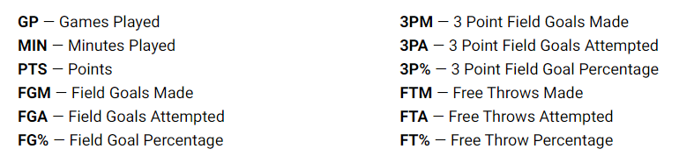
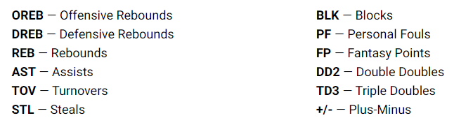
1.Glossary

Slide 19
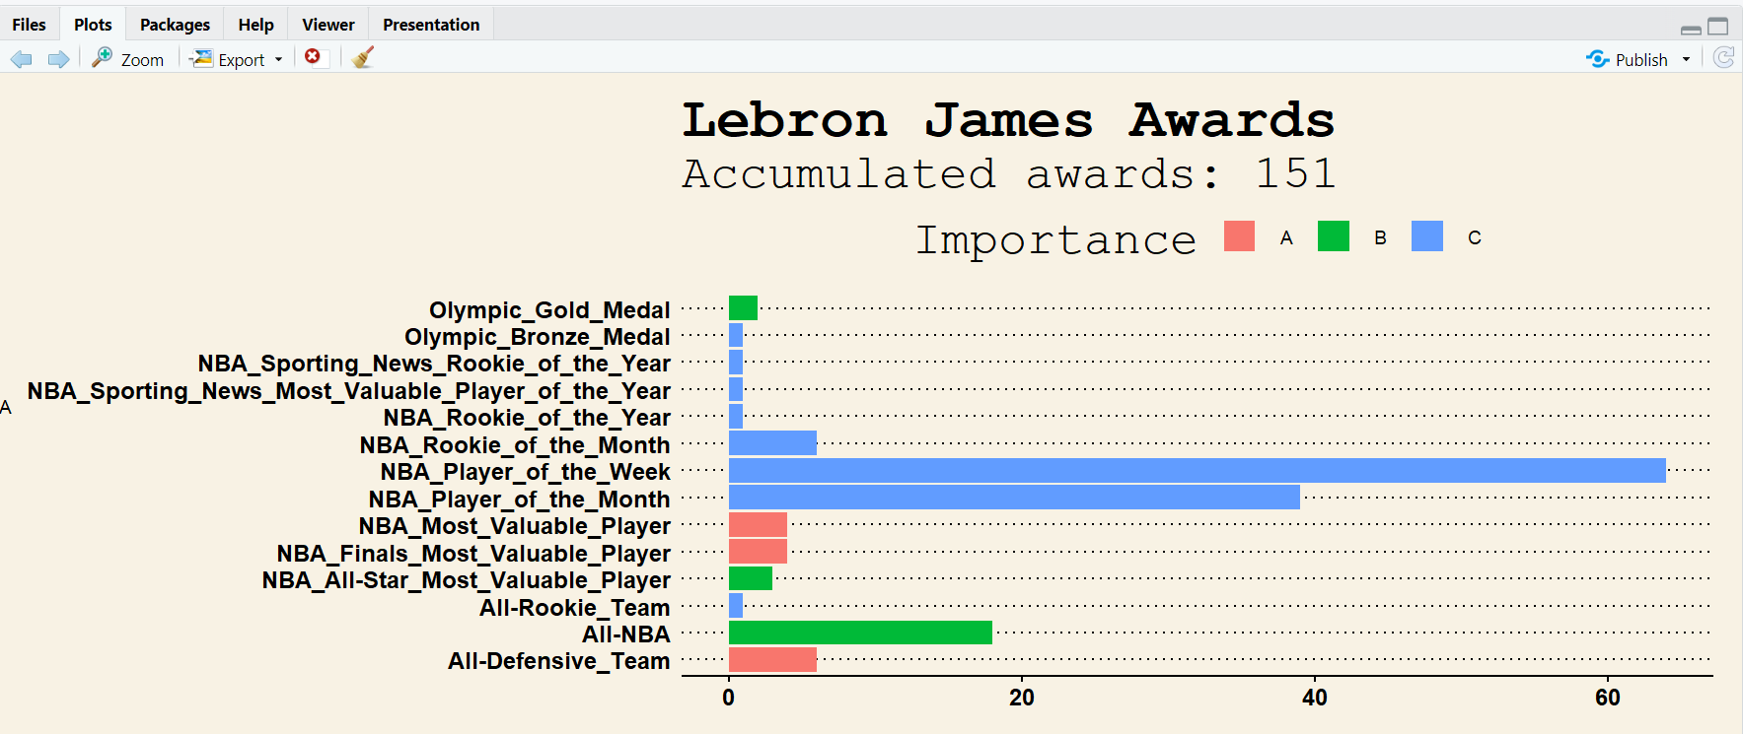
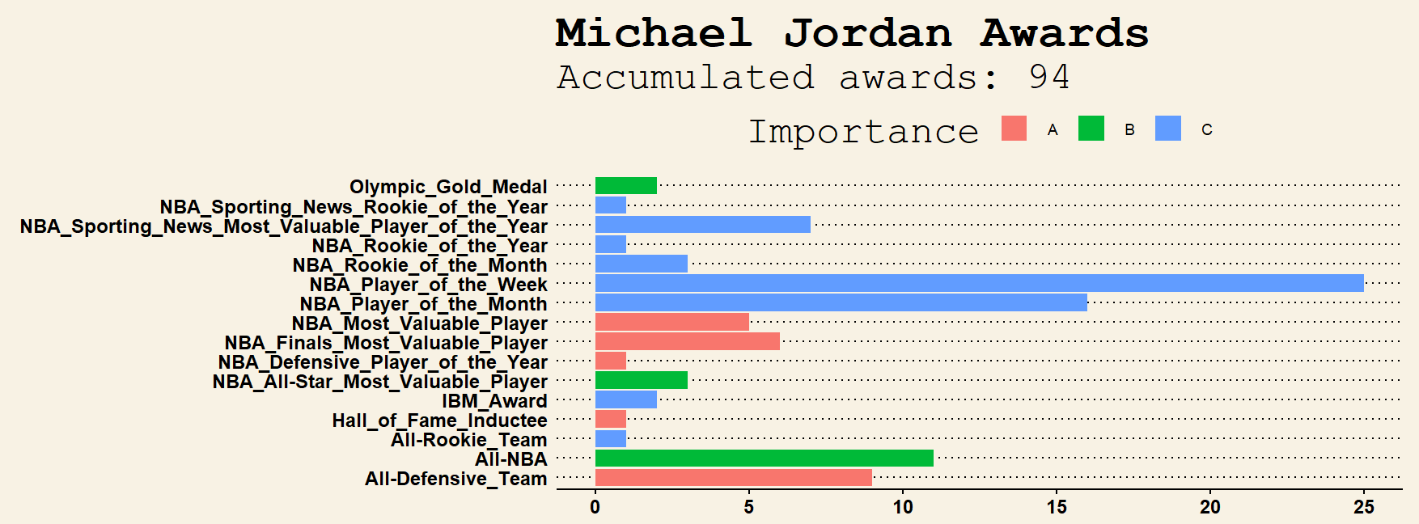
1.Accumulated Awards

Slide 20
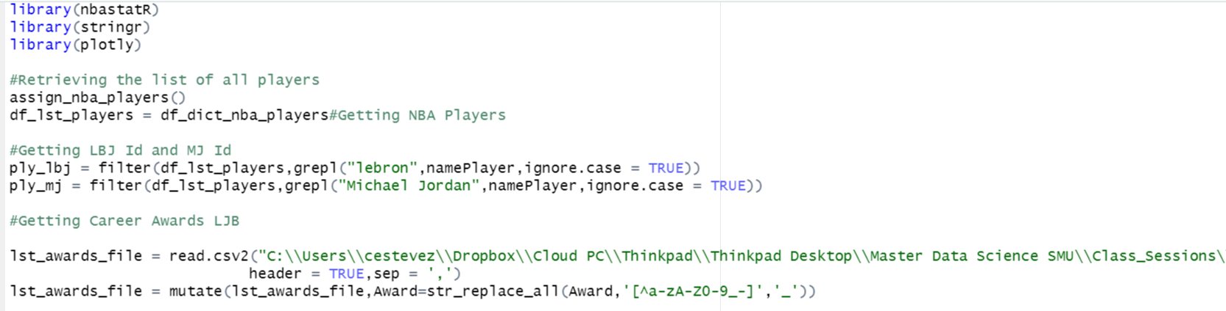
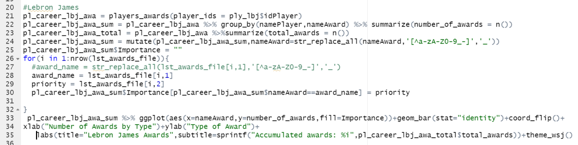
1.Accumulated Awards CODE
Loading the library
Getting the id and stat data of LBJ

Slide 21
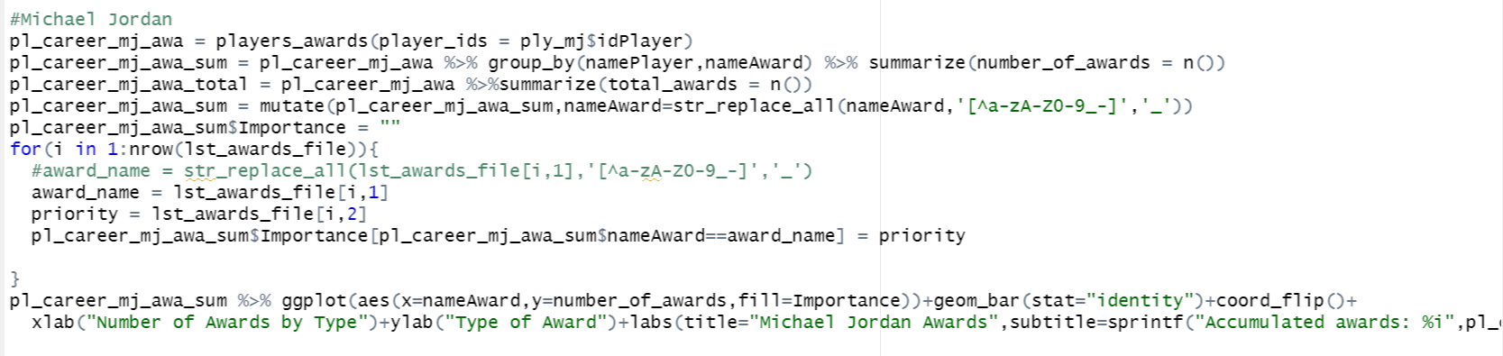
1.Accumulated Awards
Getting the data for MJ

Slide 22
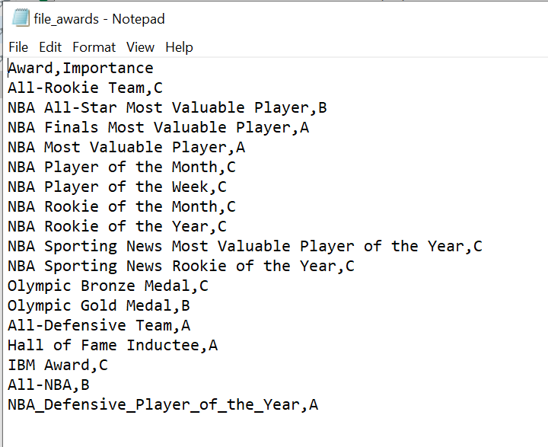
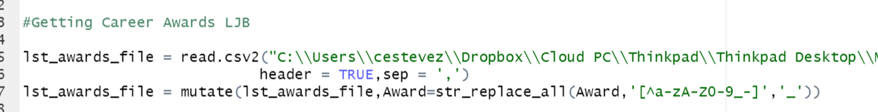
1.Importance of Awards
The library doesn’t provide a priority for the awards
We understand it was necessary giving a weight to every award. Therefore, we defined a file where we can indicate the priority for every award. It is really important to paste the same description as it appears in the API dataframe

Slide 23
1.Accumulated Awards
Conclusion:
It seems that LBJ has accumulated more awards than MJ over his career, however, when it comes to important awards he is clearly before MJ. According to the data, for example, LBJ has never won the defensive player of the year, which is a very important award
So even though LBJ has more awards, in terms of awards with high priority he is under Jordan’s accomplishments
The first data suggests that MJ is a better defensive player than LBJ, however, this might be confusing. We all know that LBJ is a very rounded player, including a great defender, even superior than Jordan.
Anyone who has watched NBA knows that LBJ has more rebounds and blocks than MJ. We need to delve deeper into the stats. So, let’s go to the following analysis.

Slide 24
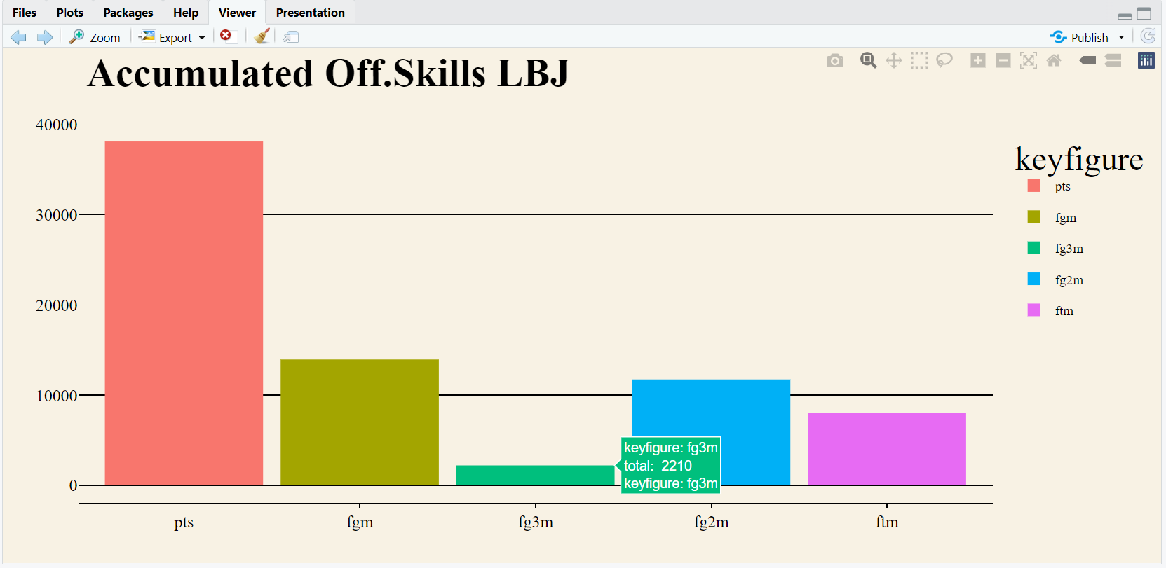
2-Offensiveness Accumulated

Slide 25
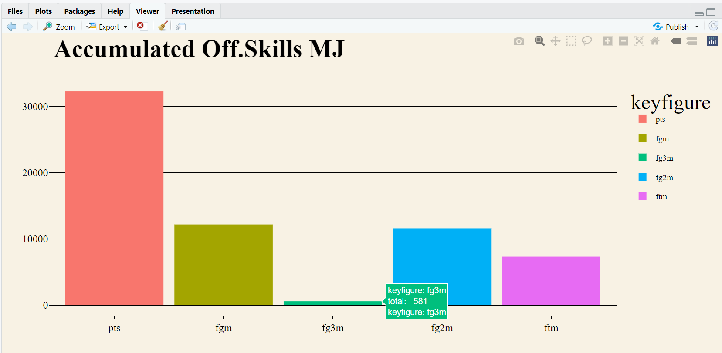
2-Offensiveness Accumulated

Slide 26
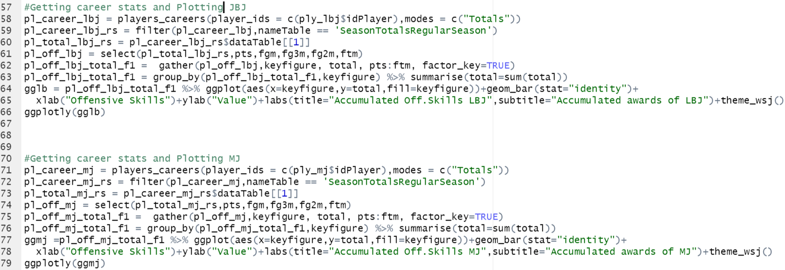
2-Offensiveness Accumulated
It was very tricky to get the data suitable for plotting, however, the function gather(Tidy data) was very useful because we were able to reorganize the data from many columns in two columns: Keyfigure and Total
I took advantage of the lesson and I was able to apply the concepts right away

Slide 27
2-Offensiveness Accumulated
Conclusion:
LBJ is superior than MJ in this category. He almost is the leader of points of all time, and he will eventually become the greatest nba scorer. On top of that, the data suggests that he is also a better three point shooter than MJ
For making a final conclusion we need to see how effective each player was, let’s go on to the next slide

Slide 28
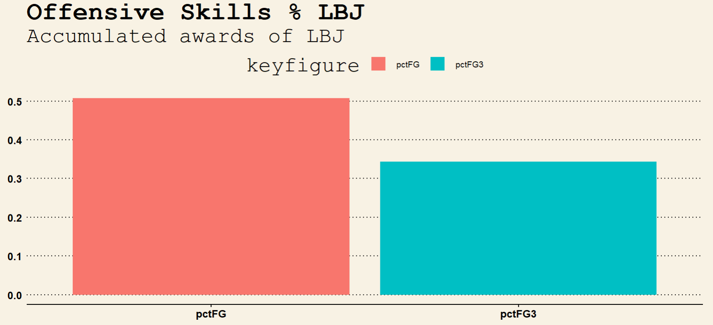
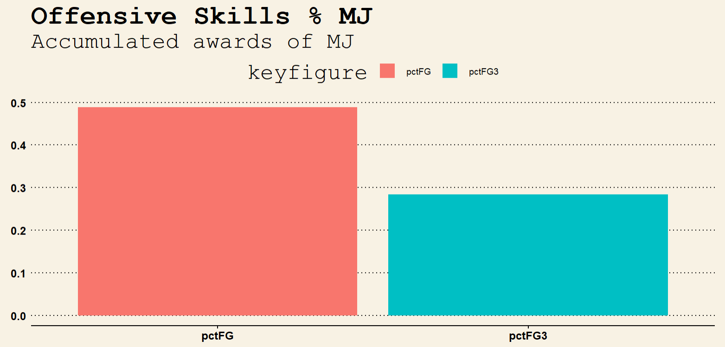
2-Offensiveness Percentage

Slide 29
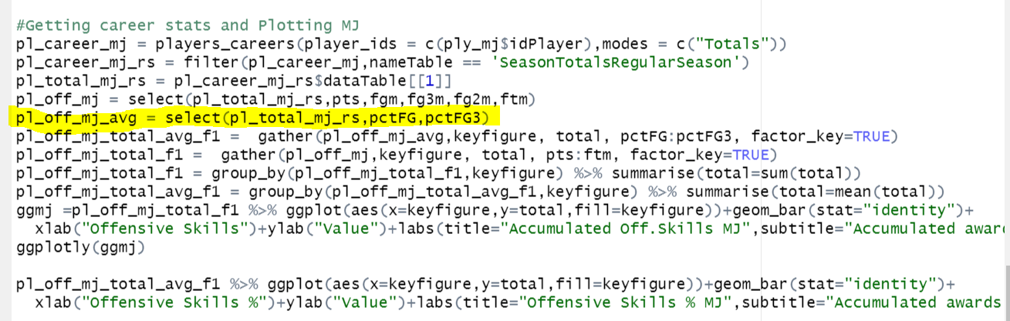
2-Offensiveness Percentage
We pretty much implemented the same code as in the previous plot, the only difference was the variables that we have used to show the Field Goals percentages

Slide 30
2-Offensiveness Percentage
Conclusion:
As the data suggest, LBJ is more effective than MJ. To really be honest, even I am surprise of theses facts, given the fact that MJ gives the impression that he is a more accurate player than LBJ
I think it all comes down, to the basket penetration. LBJ is taller than MJ and stronger, so it penetrates and attacks the basket more often. In that sense, the probability of making a shot is higher
One more thing, this data is based only in the regular season. MJ was remarkable during the postseason, and he substantially improved his level during the playoffs. The API allows you to extract this data. It will be really interesting to make that analysis, however for reasons of time, that analysis is outside the scope of this document

Slide 31
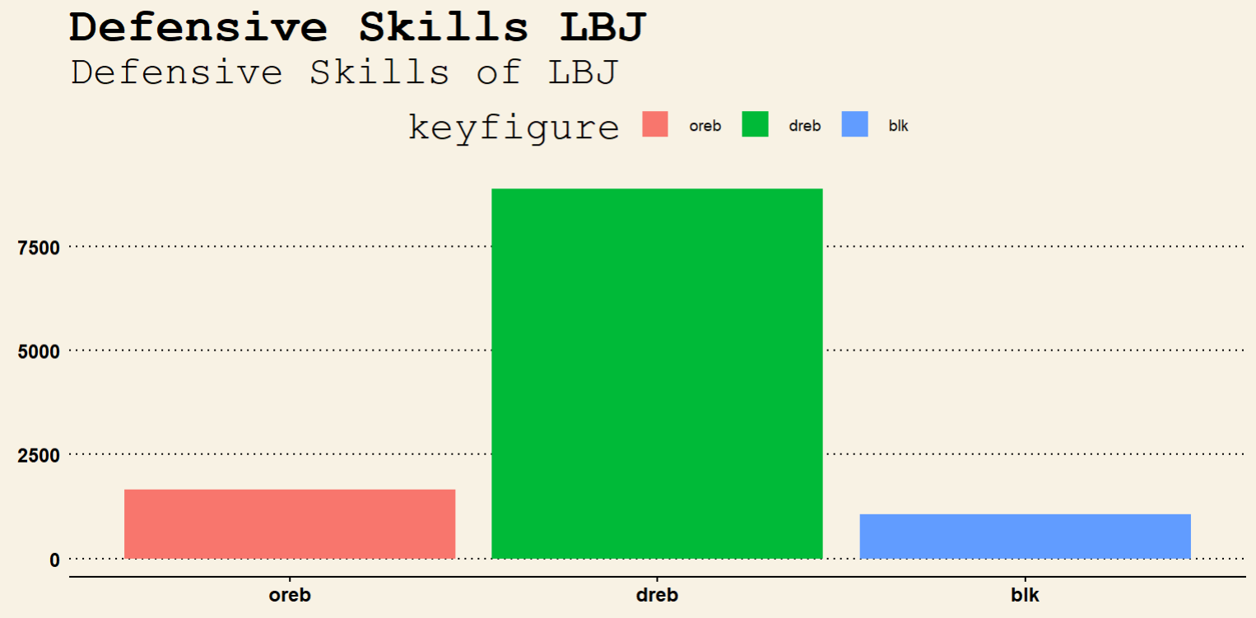
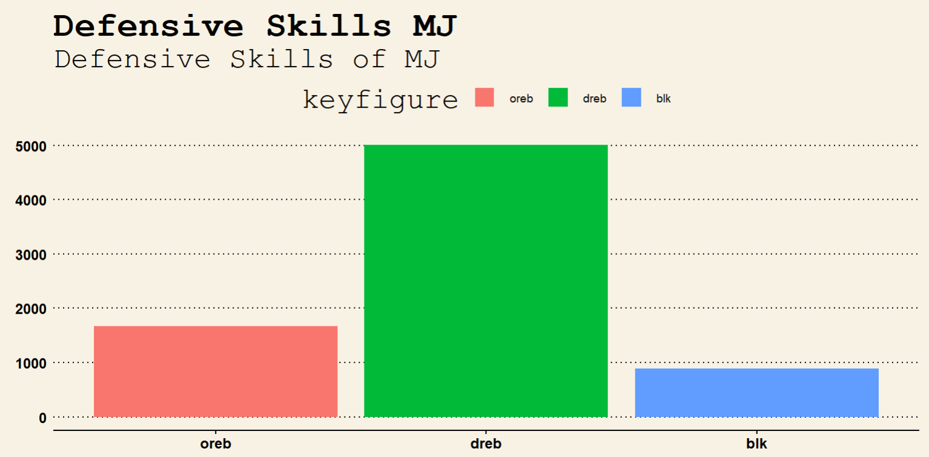
3-Defensiveness

Slide 32
3-Defensiveness
Conclusion:
As the data suggest LBJ has much more rebounds than MJ. For this reason, we believe LBJ is superior when it comes to a defensive player
Finally, we understand that based on this data LBJ is superior than MJ, however, there are other analysis we can run in order to strengthen our final decision such as the number of assistances
Another point, will be interesting to evaluate is the relationship between points by season against the season year using a scatterplot, it will give us an idea of the durability of the player, however, for reasons of time we were limited to do it
The complete implementation of this analysis is in my GIT repository, you are all very welcome to connect and use the examples
https://github.com/carlosAtestevez/SMU_MSDS_6306.git

Slide 33
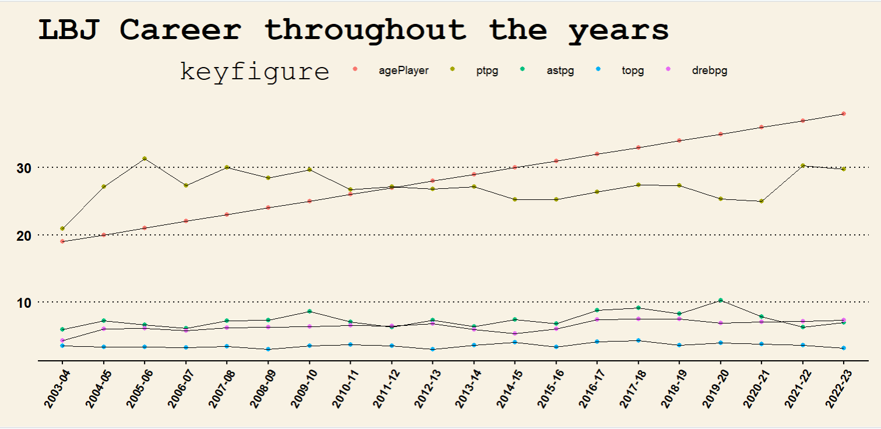

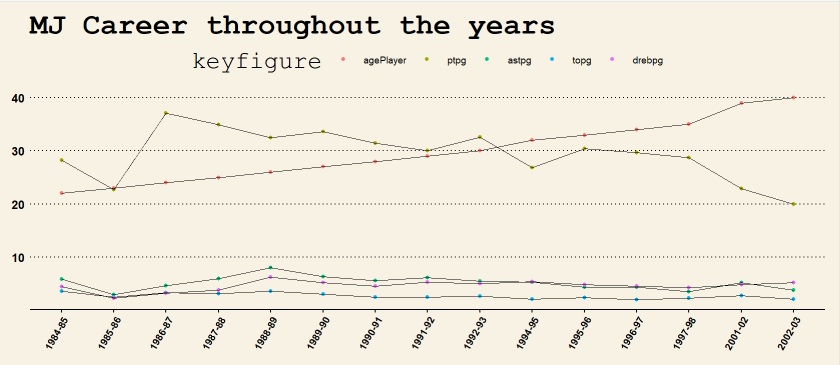

4.Longevity

Slide 34
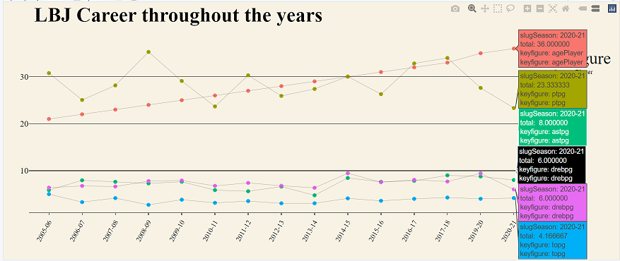
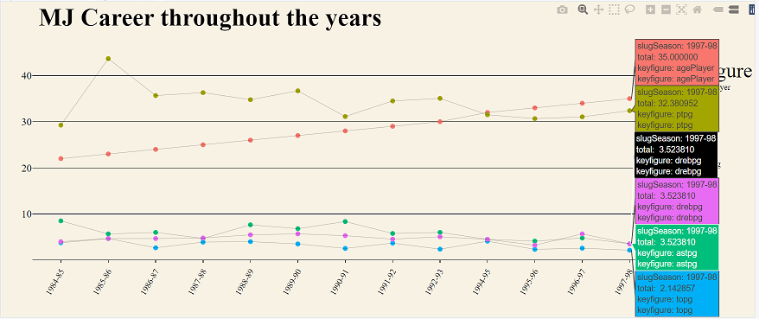
5.Post-Season performance

